Slide 1

Embiggenment
Feb 2020 Portland, OR, USA
MPI Forum Meeting

Slide 2


Slide 3

Why are we
doing this?

Slide 4
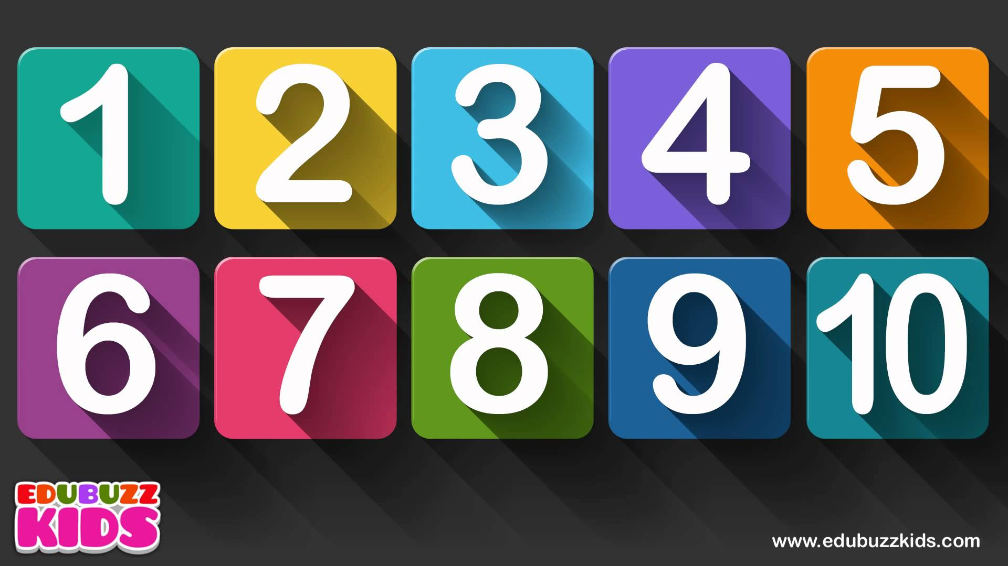
Be (trivially) 64 bit friendly to app developers
Users have been asking for this for years

Slide 5
Let’s not add new “small” APIs now, and embiggen them later
That would be foolish

Slide 6
We have “count” API arguments for a reason
Who wants a unique datatype for every operation?

Slide 7
Things you can’t do without BigCount
RMA disallows user-defined ops / datatypes
See Jeff Hammod BigMPI slides (1, 2)

Slide 8

New things since ABQ
All Chapter Committees have reviewed
MPI_TYPE_GET_ENVELOPE / CONTENTS weirdness
Define MPI_UNDEFINED comparison to embiggened values
Between (int ↔ MPI_Count) and (INTEGER ↔ INTEGER(KIND=MPI_COUNT_KIND))
MPI_BUFFER_DETACH LIS kind change (non-negative integer → integer)
To accomodate the (new) use of MPI_UNDEFINED
Embiggened callback functions for MPI_OP_CREATE, MPI_DATAREP_REGISTER

